Slide 1


Lesson 15
Healthy eating habits
UNIT 4

Slide 2
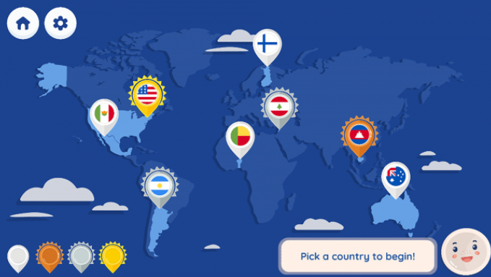
Pick Your Plate! A Global Guide to Nutrition
Travel around the world with Plato to learn about building healthy meals. Pick your favourite plates for morning, midday, and evening meals. Be sure to meet your daily nutritional needs while not going over your budget!
https://ssec.si.edu/pick-your-plate

Slide 3
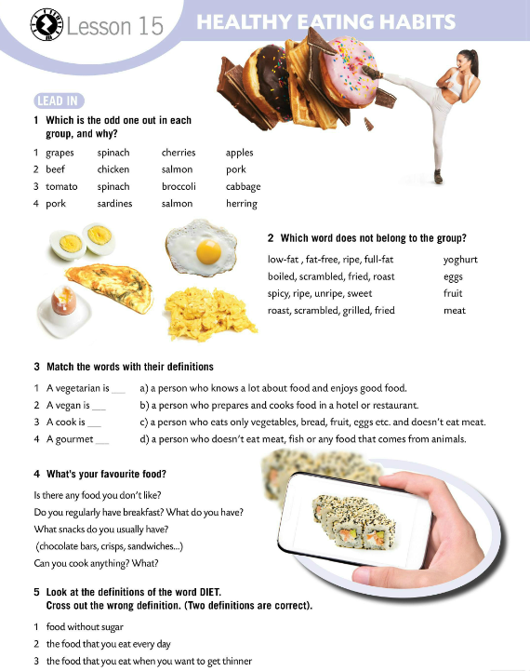
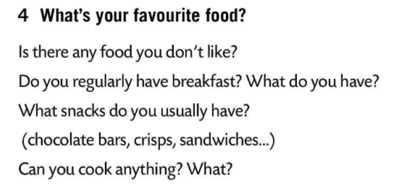
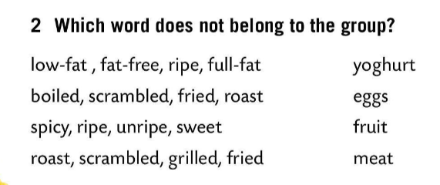
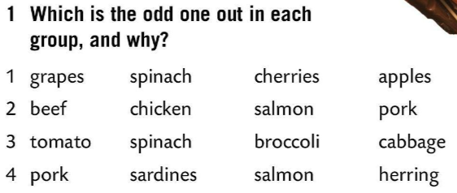
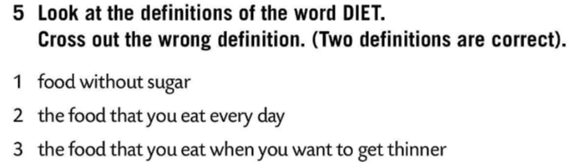
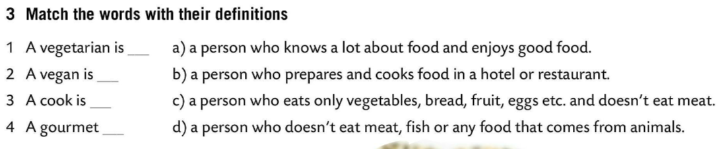
Which is the odd one out in each group, and why?
Check.
Which food does not belong to the group?
c)
Check.
d)
b)
a)
Match the words to their definitions.
Check.
Look at the definitions of the word DIET. Cross out the wrong definition.

Slide 4
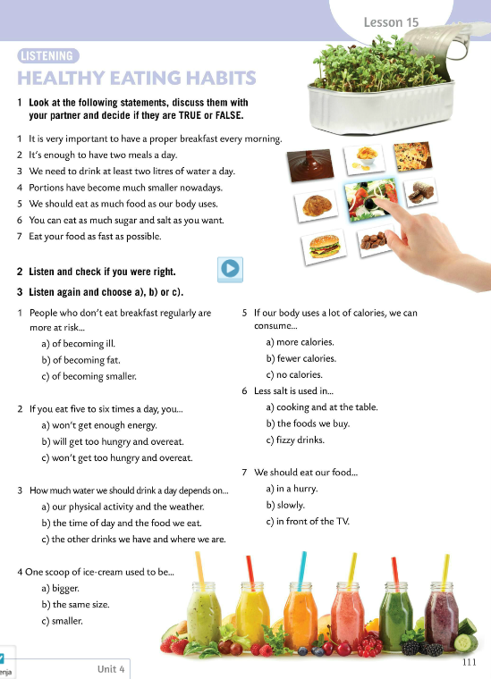
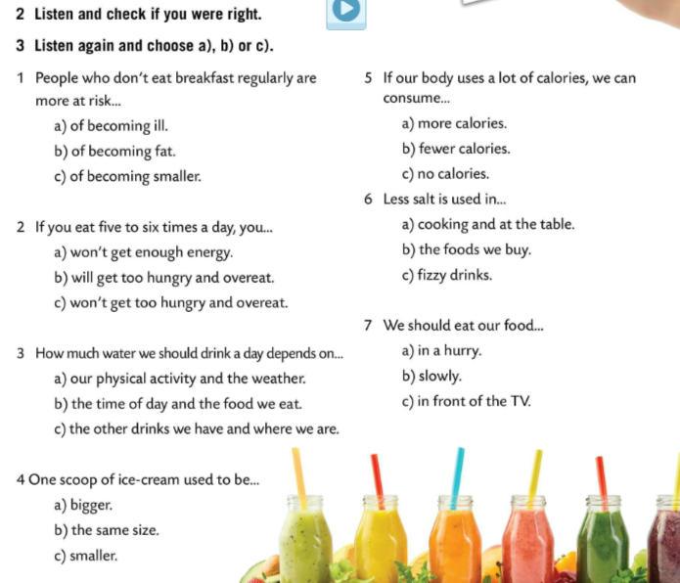
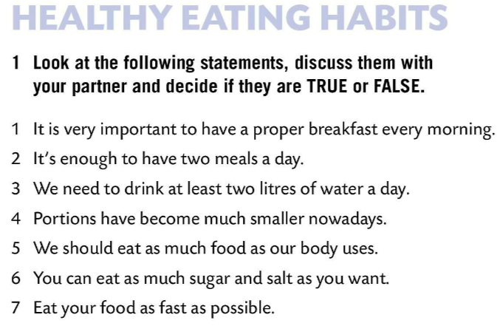

Look at the following statements, discuss them with your partner and decide if they are true or false.
Listen to the recording and check if you were right.
TRUE
FALSE
FALSE
FALSE
TRUE
Listen again and choose a), b) or c).
FALSE
FALSE
Check.
True or false?
https://wordwall.net/play/853/800/210

Slide 5
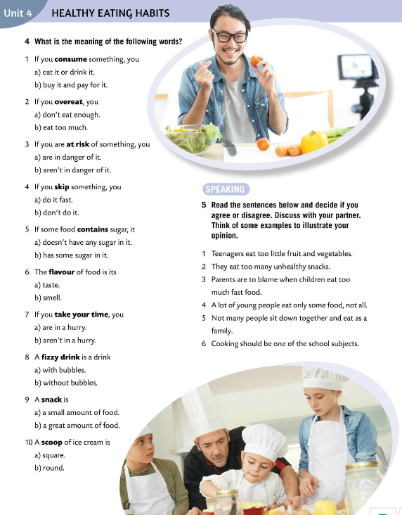
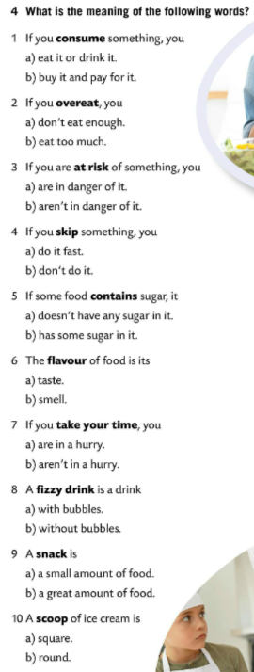
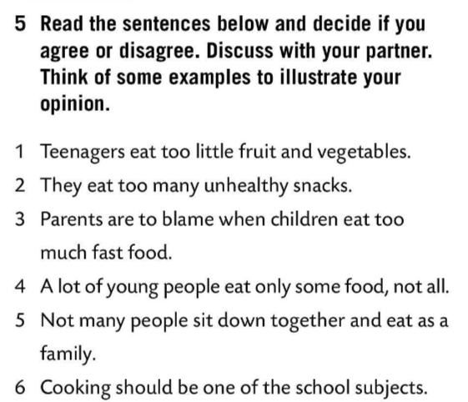
What is the meaning of the following words?
Check.
Copy.
consume – uzimati, upotrebljavati
overeat – prejedati se
at risk – biti u opasnosti
skip – preskočiti
contain – sadržavati
flavour – okus
fizzy drink – gazirani napitak
snack – zakuska
scoop of ice cream – kugla sladoleda
Read the sentences below and decide if you agree or disagree. Discuss with your partner. Think of some examples to illustrate your opinion.

Slide 6
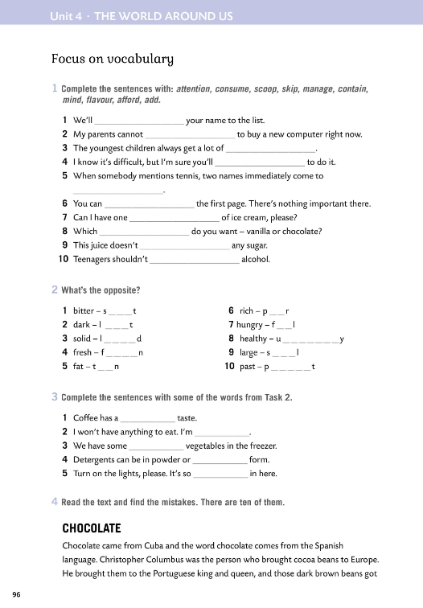

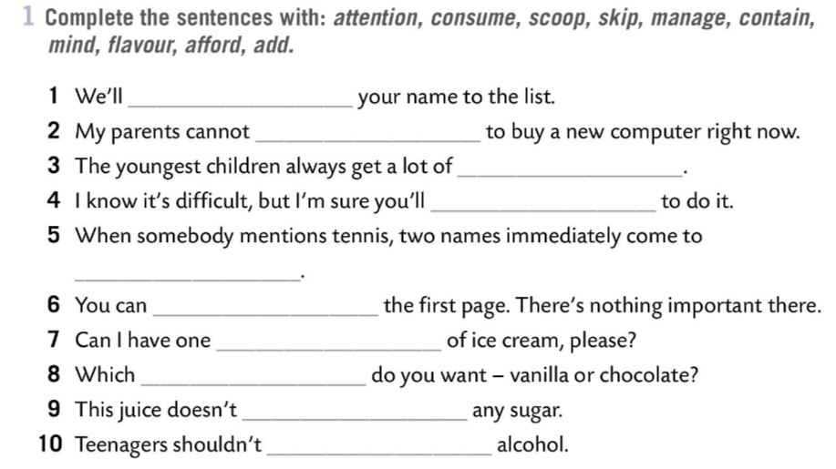
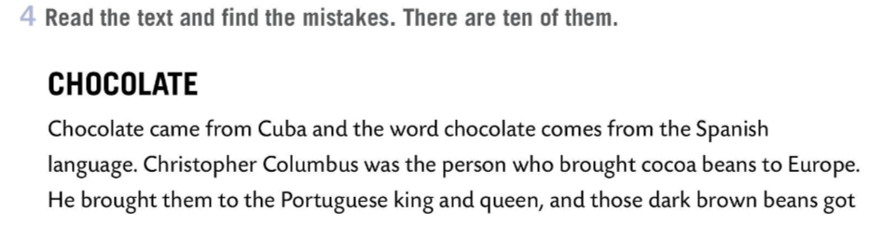
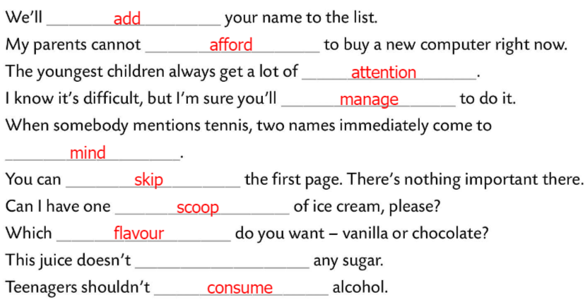
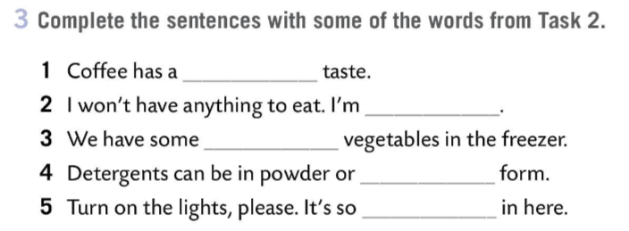
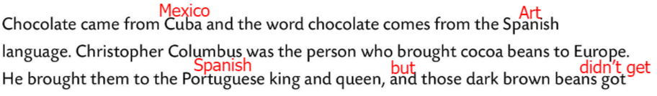
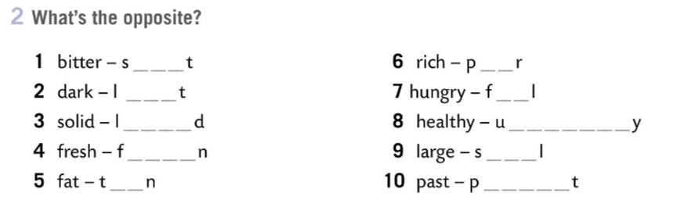
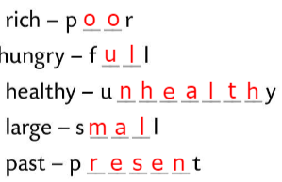
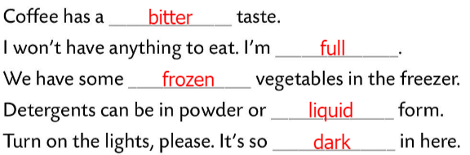
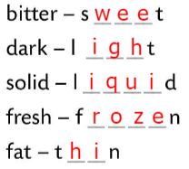
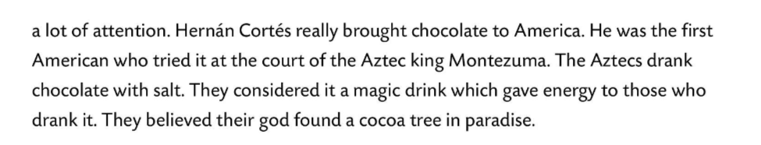
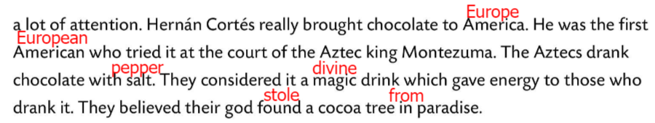
Workbook, page 96
Complete the sentences with: attention, consume, scoop, skip, contain, mind, flavour, afford, add.
Check.
What’s the opposite?
Check.
Complete the sentences with some of the words from Task 2.
Check.
Read the text and find the mistakes. There are ten of them.
Check.

Slide 7
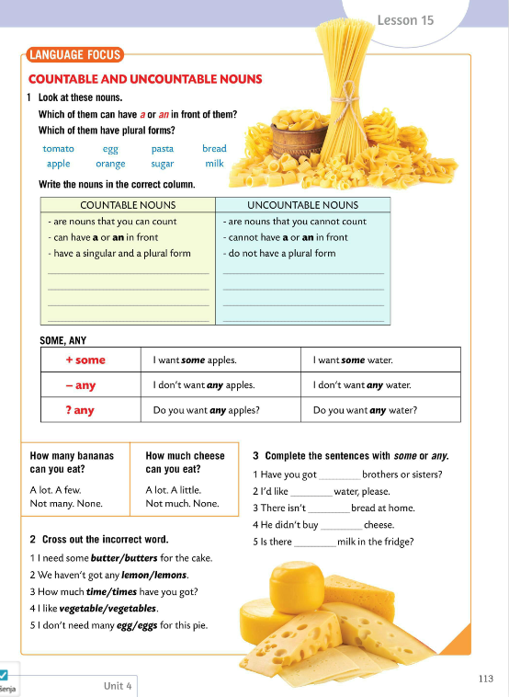
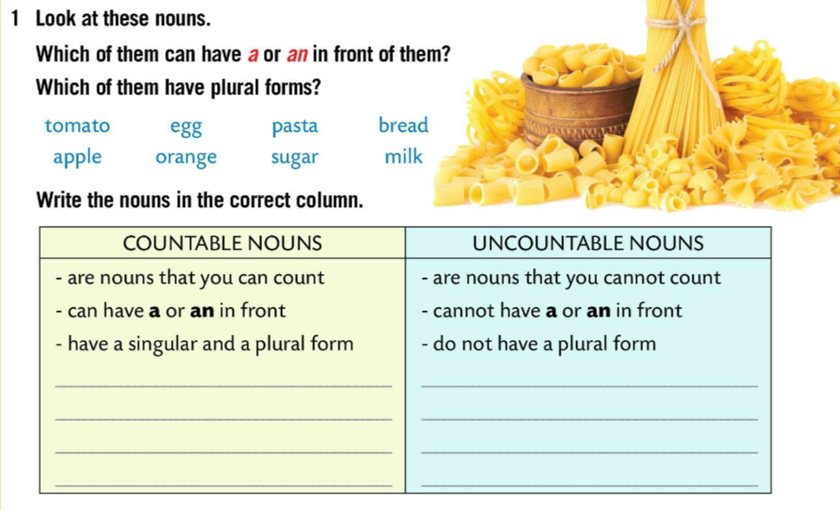
LANGUAGE FOCUS
Which of them can have a or an in front of them?
a tomato, an egg, an apple, an orange
Which of them have plural forms?
pasta, bread, sugar, milk
Write the nouns in the correct column.
Check.
tomato, egg, apple, orange,
bread, pasta, sugar, milk
Countable nouns:
can be counted
have a or an in front (in singular)
have a singular or a plural form.
Brojive imenice su imenice koje možemo prebrojiti, koje mogu ispred sebe imati član a ili an u jednini te koje imaju jedninu i množinu.

Slide 8
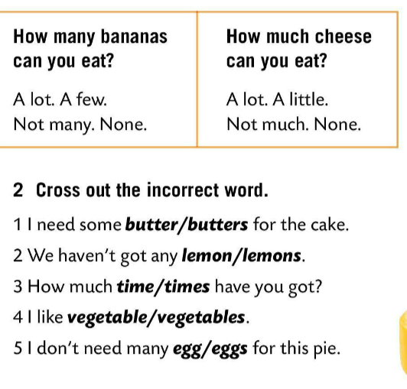
Uncountable nouns are nouns that cannot be counted, cannot have a or an in front and do not have a plural form.
Nebrojive imenice su imenice koje ne možemo prebrojiti, koje ne mogu ispred sebe imati član a ili an i koje nemaju množinu.
how many countable nouns
how much uncountable nouns
How many koristimo sa brojivim imenicama, a how much sa nebrojivim imenicama.
tomato, egg, apple, orange,
bread, pasta, sugar, milk
Cross out the incorrect word.
Check.

Slide 9
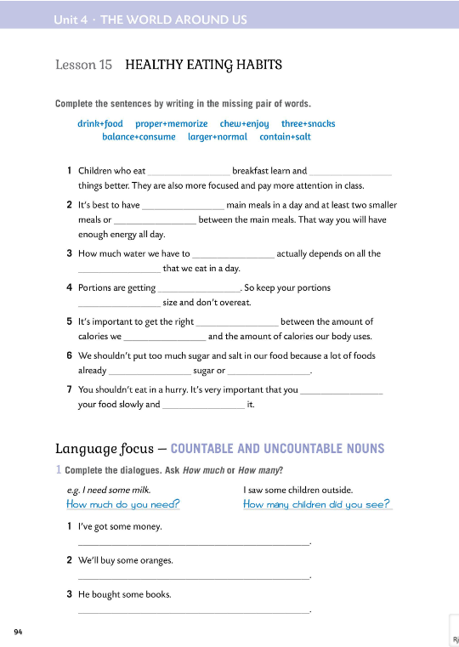
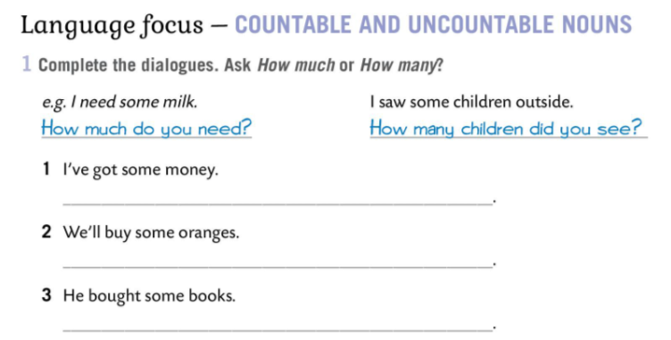
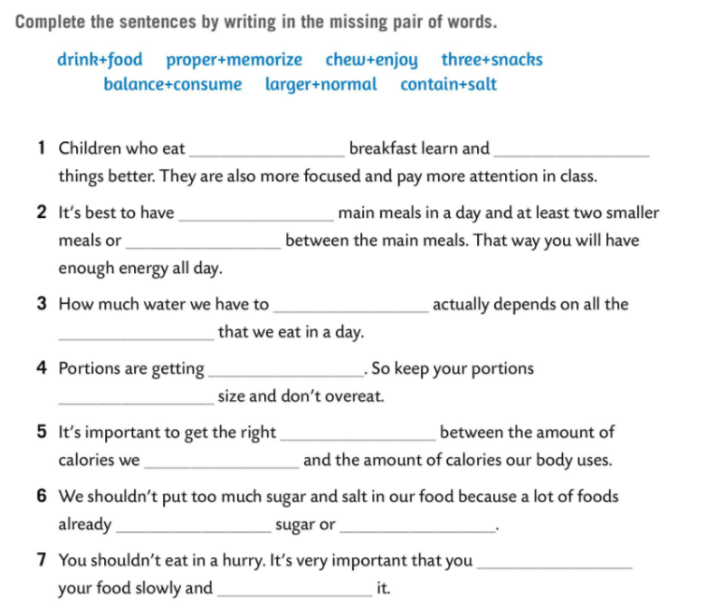
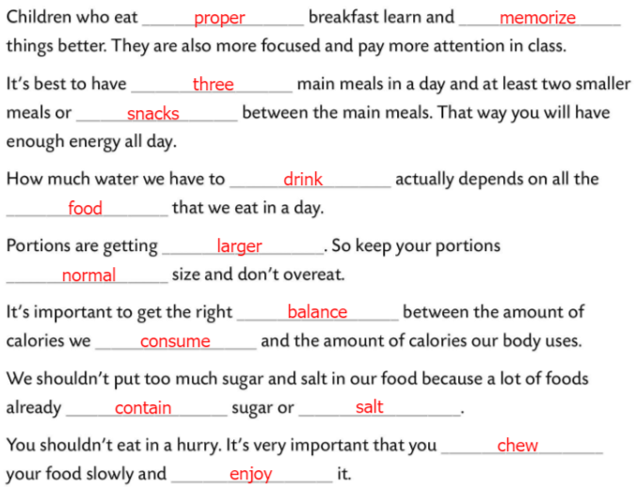
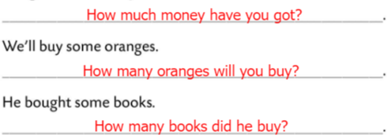
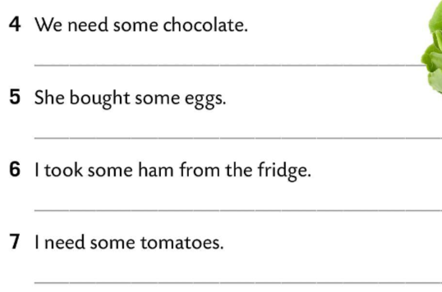
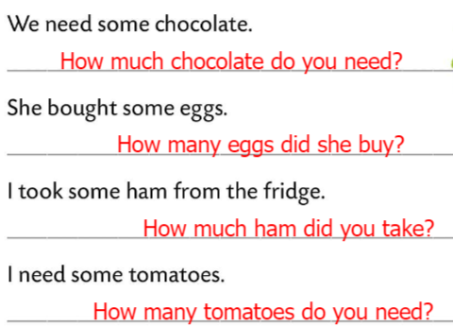
Workbook, page 94
Complete the sentences by writing in the missing pair of words.
Check.
Complete the dialogues.
Ask How much or How many?
Check.

Slide 10
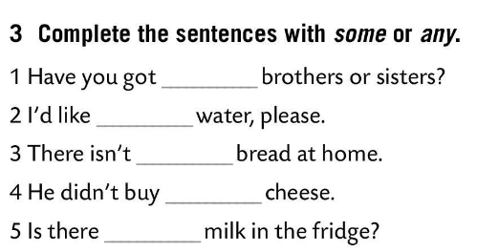
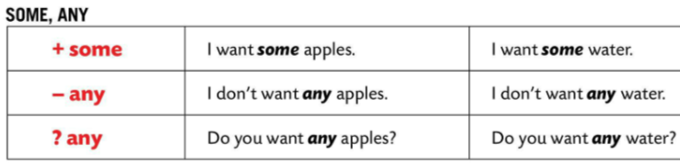
We use:
some for affirmative sentences
any for questions or negative sentences.
Usually, both 'some' and 'any' can only be used with countable plural nouns or uncountable nouns.
Some koristimo za jesne rečenice, a any za niječne i upitne rečenice. I ‘some’ i ‘any’ uglavnom se koriste s brojivim imenicama u množini ili nebrojivim imenicama.
any
some
any
any
any
Complete the sentences with SOME or ANY.
Check.

Slide 11
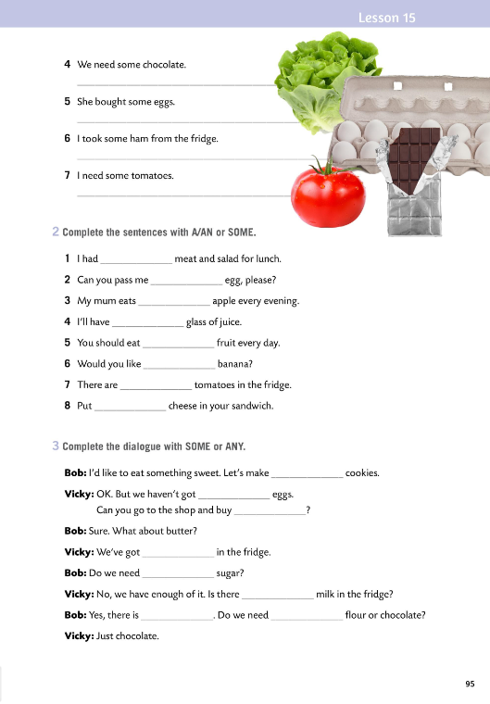
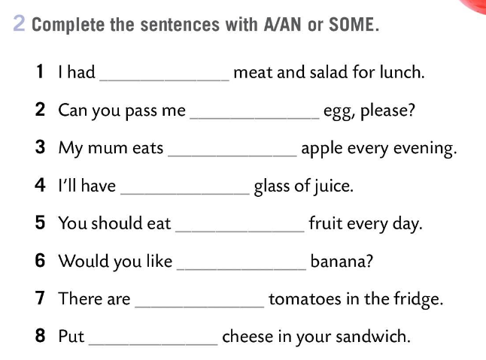
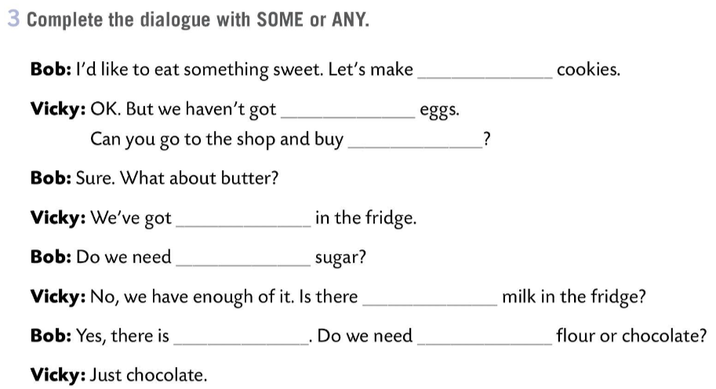
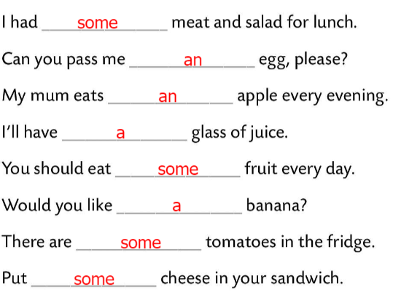
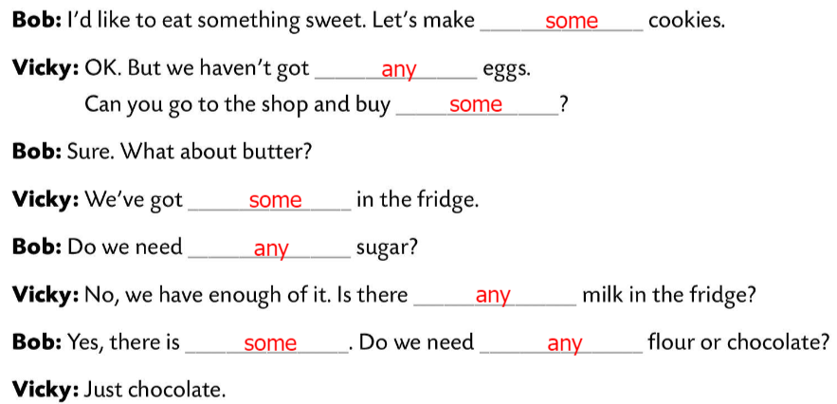
Workbook, page 95
Complete the sentences with A, AN or SOME.
Check.
Complete the dialogue with SOME or ANY.
Check.

Slide 12
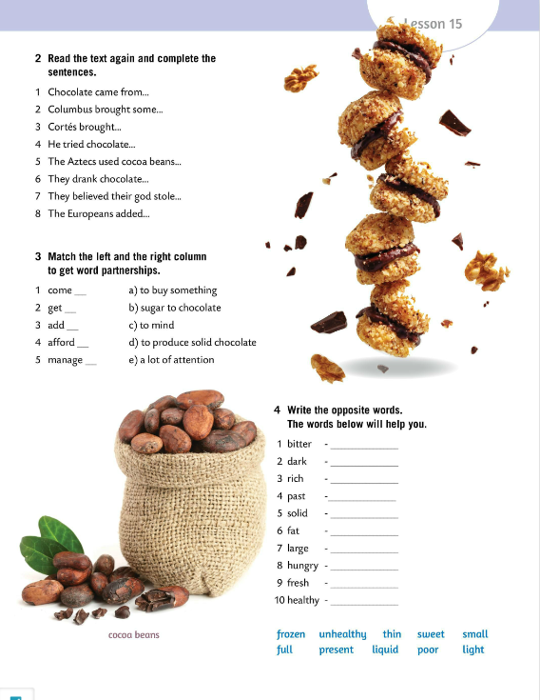
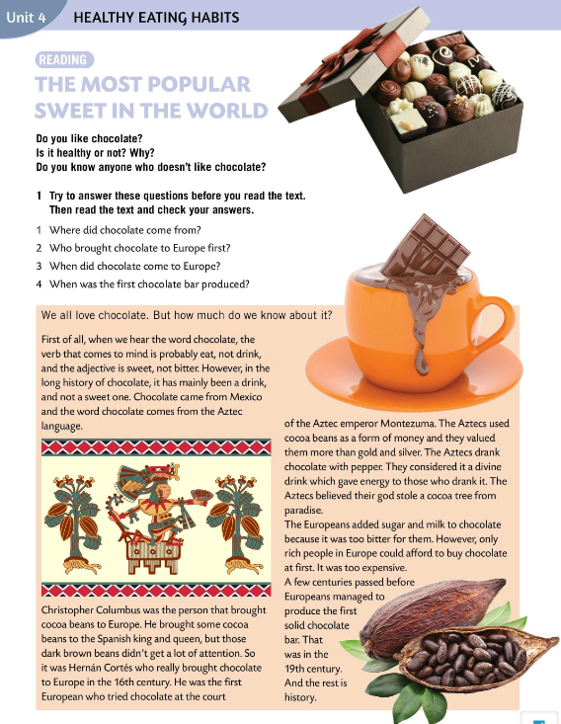
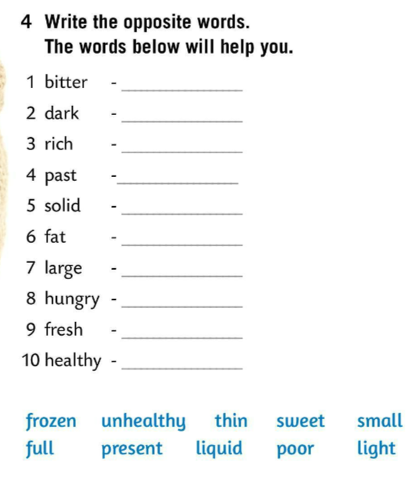
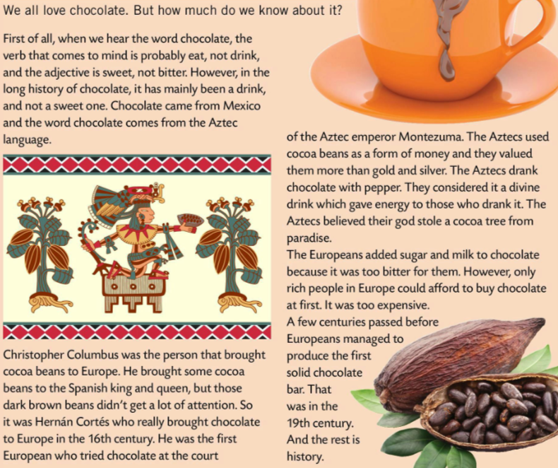
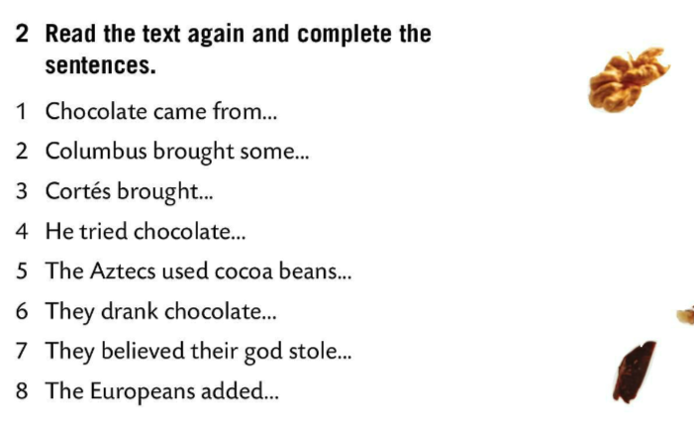
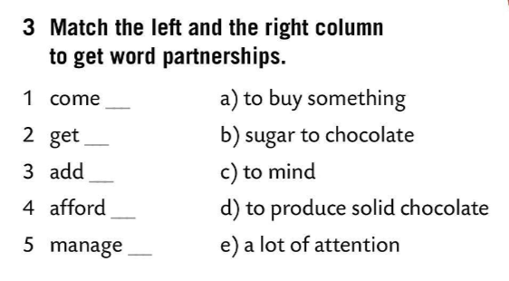
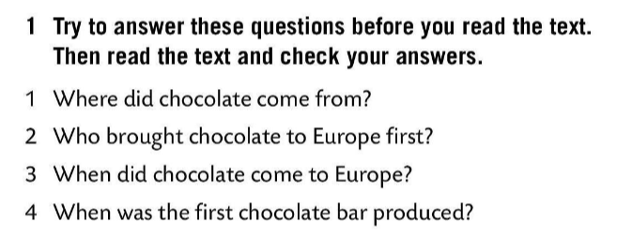
Do you like chocolate?
Is it healthy or not? Why?
Do you know anyone who doesn’t like chocolate?
sweet
light
Try to answer these questions before you read the text.
Then read the text and check your answers.
poor
Mexico.
present
c)
Cocoa beans to Europe.
liquid
Chocolate was brought in from Mexico.
e)
chocolate to Europe.
thin
at the court of the Aztec emperor.
Check.
Cortes first brought chocolate to Europe.
b)
small
as a form of money.
In the 16th century.
full
a)
with pepper.
Read the text again and complete the sentences.
In the 19th century.
frozen
d)
a cocoa tree from paradise.
unhealthy
sugar and milk to chocolate.
Check.
Match the left and the right column to get word partnership.
Check.
Write the opposite words. The words below will help you.
Check.

Slide 13
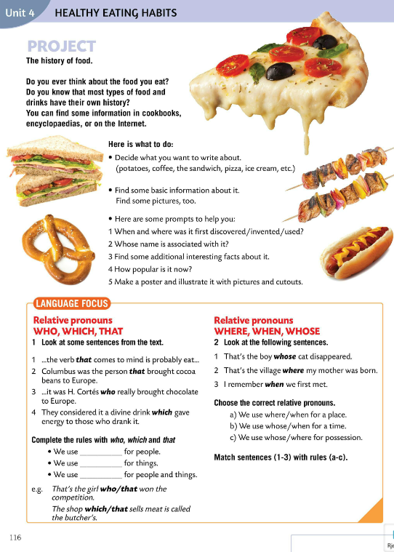




Do you ever think about the food you eat?
Do you know that most types of food and drinks have their own history?
You can find some information in cookbooks, encyclopedias, or on the Internet. Follow the instructions and make a mini-project.
Zamjenicu WHO koristimo kada govorimo o ljudima.
Zamjenicu WHICH koristimo kada govorimo o stvarima.
Zamjenicu THAT koristimo za osobe i stvari.
WHO
WHICH
THAT
Read sentences in the LANGUAGE FOCUS box.
Do you notice relative pronouns?
Complete the rules with WHO, WHICH and THAT.
Check.

Slide 14

Look at the following sentences. Bolded words are also relative pronouns: WHERE, WHEN, WHOSE.
Choose the correct relative pronouns.
Check.
We use WHERE for a place.
WHERE koristimo za mjesta.
We use WHEN for a time.
WHEN koristimo za vrijeme.
We use WHOSE for possession.
WHOSE koristimo za vlasništvo.
1 – c)
2 – a)
3 – b)
Match sentences (1-3) with rules (a-c).

Slide 15






Workbook, page 97
Fill in the gaps with WHO, WHICH, WHERE, WHEN, WHOSE.
Check.
Complete the sentences with WHO, WHICH, THAT, WHERE, WHEN, WHOSE and then do the puzzle below.
Check.

Slide 16




Choose the correct pronoun to complete the sentences.
Check.
which
Fill in the gaps with WHO, WHICH, WHOSE, WHERE and WHEN.
where
whose
when
Check.
who
which
who
Finish the sentences any way you like.
where
Choose the correct relative pronoun.
https://learningapps.org/watch?v=p3mc2gbaa20

